Slide 1
CHAMPION HOME
HEALTH CARE
CNA ORIENTATION

Slide 2
WHAT IS CHAMPION HOME HEALTH?
Champion Home Health Care is a private, non-medical home health agency – meaning that we provide personal care, homemaking and companion services
Our focus is on servicing those clients that, without our care, would not be able thrive in their homes.
Our client base is comprised of Veterans, those that are county program eligible and Medicaid waiver.
Clients serviced by Champion Home Care may need as little as one to two hours of service – we have no minimum hour requirements.
We have an Administrative Staff that is dedicated to assuring that the needs of our clients are met in a timely as well as caring manner.

Slide 3
Expectations of our CNAs
Please read field manual, located on this website, before going further
Champion CNAs are chosen to work based on our stringent professional standards
Champion CNAs are expected to consistently provide care with compassion, empathy and dedication
Champion CNAs are required to effectively communicate with our clients as well as the Administrative Staff – providing necessary information to assure consistent and proper care- refer to Field Manual for details.

Slide 4
CHAMPION PROCEDURES
When chosen to work for Champion Home Health, we are not training you to work as a CNA but there are certain procedures that must be followed in order to continue to work for Champion

Slide 5
Who, when and why do I call the office?
The following phone numbers are to be entered into you phone now:
  Staff Line – 352-316-7000 – This number is to be called for all Champion questions or concerns. This phone will be answered by someone during the hours of 6am – 5pm. After 5pm if you have an urgent issue that can’t wait until 6am the next morning then you will call Sherri at 352-328-1596.
    If your call goes to Voice Mail, you MUST leave a message, slowly and clearly speak your name, phone number and the reason for your call ( DO NOT SAY PLEASE CALL ME). We must know the reason for your call.
  Sherri – 352-328-1596 – This number is to be called when you have an issue that needs to be handled quickly and you have already left a message on the staff line and have not received a call back. If Sherri’s phone goes to voice mail, please clearly state your name, number and the reason for your call.
  Lee Ann – 804-658-7984 – this number is to be called for Sunshine client call in/schedule issues (Please refer to field manual for Sandata procedures)
  If administrative staff calls from their cell phone and requests that you call them back, then you are allowed to do so.
  THIS PROCESS MUST BE FOLLOWED AS LISTED TO ENSURE THAT DELAY OF CLIENT CARE DOES NOT HAPPEN.

Slide 6
How do I get my schedule?
Champion Home Health Care uses an on line scheduling program known as SharePoint. Once you have been scheduled for your meet and greet, you can expect to receive an email from Lee Ann Benton with a temporary login and password.
The scheduling system will be discussed during the meet and greet.
Your schedule will be emailed to you each Friday for the following week that starts on Mondays. You MUST review AND confirm your schedule upon receipt of the email.
Administrative staff is notified once your schedule has been confirmed. It is then expected that you will work the schedule as posted. If you have questions concerning your schedule you must call the staff line.

Slide 7
Accessing weekly schedule
Once you have been accepted as a contractor for Champion Home Health, you will receive an email from a member of the Champion Staff. This email will contain you login ID and a temporary password.
Go to the following website to log in with this information
  champhhc.azurewebsites.net
  Enter you ID xxxxxx@champhhc.com
  Enter the temporary password
  You will be required to change your password. Change it to Champion1!
  Once done you will have access to your schedule and service orders for your clients.

Slide 8
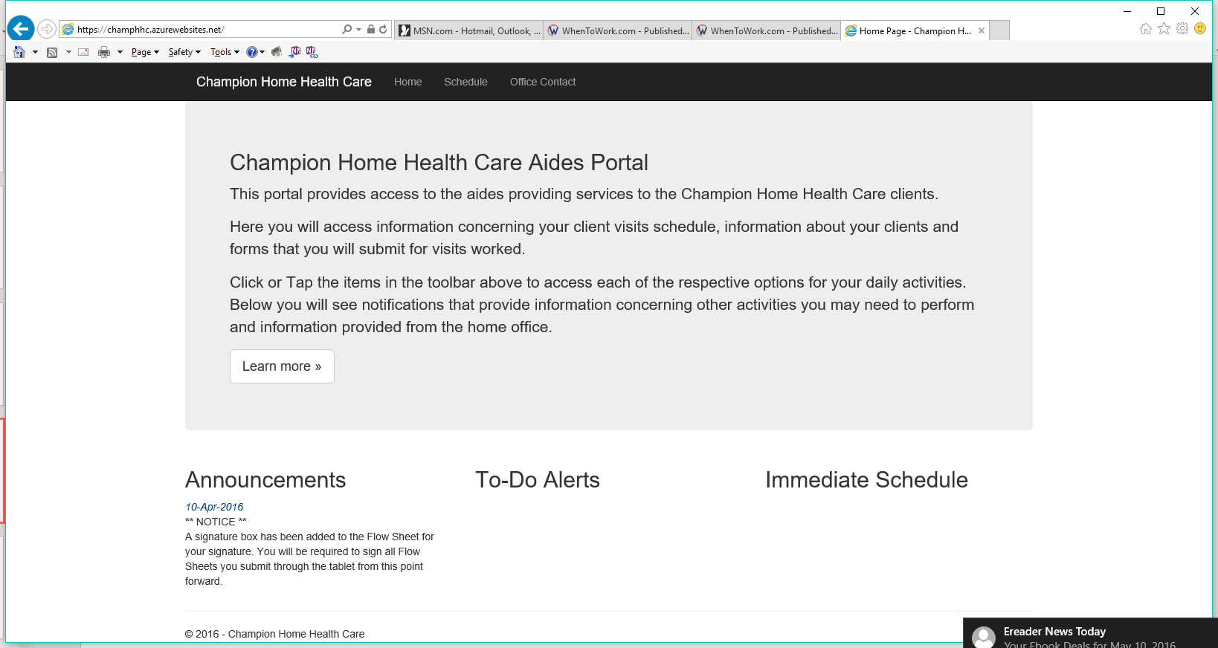
Signing into SharePoint
Please note the information located on your home page
Any important notices
Items that need your immediate attention
Your immediate schedule
Your weekly schedule –
See next slide for details

Slide 9
Weekly schedule
This is a sample view of a schedule – Client Name has been omitted due to HIPAA
Schedule Week
Schedule Day and Date
Client Name
Shift Time
Contract Type and duration

Slide 10
How will I know my client information?
HIPAA- Protected Health Information –
Client information will be located on SharePoint. Once you have received you login and password you will have access to your clients service orders.
The client information is on a SERVICE ORDER and contains everything the CNA needs to know to provide the necessary care for each client assigned
While reviewing your schedule be sure you have a service order for each client. If not then you will call the Staff Line (to be discussed later)

Slide 11
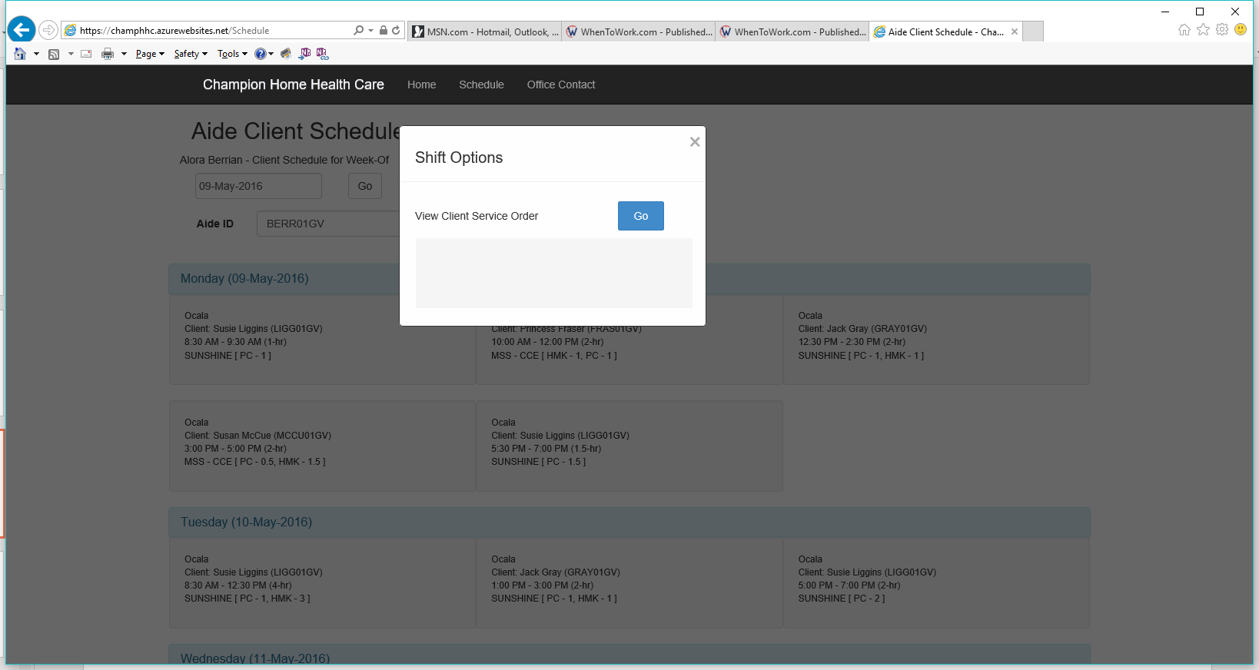
Accessing Service Orders
To view the client service order, click on the shift, then click on Go in the Shift Options Box

Slide 12
Service Order
The service order is shown here in 2 parts due to the size of the viewing screen for this presentation. Any information you need about your client will be found on the service order. Name, address, basic information,
Diagnosis, condition and services provided.

Slide 13
DOCUMENTATION
Your time worked and care provided is recorded on a Champion Flow Sheet. The information that you enter on the flow sheet is used for weekly pay and billing. It is important that all information is correct.
The flow sheet to be used is available on this website, or at the Gainesville office.

Slide 14
DOCUMENTATION ACCURACY
Flow sheets must reflect the care provided as well as your arrival and departure time – more details of this topic will be discussed during the meet and greet
Flow sheets are not to be filled out and client signatures not obtained until all care has been provided for the day. Doing so is fraud and will be reported immediately.
All documentation must be completed using blue ink entering client’s name, printed and as it appears on the service order.
NO WHITE OUT or ERASING or SCRIBBLING. If a mistake occurs draw 1 line through and initial.
Flow sheets are due by 6pm each Sunday. You can fax your flow sheets to 352-240-1530 or install Cam Scanner on your phone, scan and email to champoffice@champhhc.com

Slide 15
Champion Flow Sheet
Please fill out the Champion Flow sheet as listed below noting that there are 8 date columns
Fill in week ending date at top and bottom of flow sheet
  Sunday – Sat for ECAC and MSS only
  Monday – Sun for all other Agencies
Print Client name and Aide Name at the top and bottom of the flow sheet
Date every column no matter how many visits
Check off ALL duties performed to include Universal Precautions
Enter the total hours for each service provided
Enter the total service hours ( PC + HMK + COMP or RES)
Aide and Client are to sign each day
When providing Respite for a client, check off all duties performed for PC, HMK and Companion and check the Respite Provided Box
Enter in start and end time using AM and PM
Check the appropriate Contract Type
Flow sheets are due by 6pm on Sunday of each week
Fax to 352-240-1530 or
Scan using CamScanner – free app for your phone and email to champ.office@champhhc.com
If your flow sheets are going to be late you MUST notify Sherri prior to 6pm on Sunday.
Sunday – Saturday for MSS and ECAC
Monday – Sunday for all Other Agencies

Slide 16
Client/Family and CNA Interaction
The most successful CNAs:
  Show up on time, dressed appropriately, ready to work with their phones out of sight and on vibrate or silent mode
  Allows the client/family to maintain control while getting the job done correctly
  Knows the appropriate topics of discussion to have with the client
    No personal information shared
    No discussion of other clients
    No complaining about other aides, clients or Administrative staff
    No complaining about drive time or hours worked
  If the client requests you to perform a duty that is not listed on the service order then a call to the staff line is to be made immediately. Respectfully explain to the client that you must get verification before performing the requested task. (i.e. Aide is not allowed to transport unless specifically stated)

Slide 17
Client Types
As stated earlier Champion subcontracts with various agencies and companies
  Altrusa House (SR)
  Elder Care of Alachua County (ECAC)
  Brain and Spinal Cord Injury (BSCI)
  Marion Senior Services (MSS)
  Sunshine Health (SUNSHINE)
  United Health Care (UHC)
  Veterans Administration (VA)
Each company has certain documentation requirements that must be followed in order to maintain the current contractual agreement.

Slide 18
County Agencies
Elder Care of Alachua County(ECAC)
Marion Senior Services (MSS)
These county agencies require dating on flow sheet as:
  Sunday – Saturday
All other Agencies require dating on flow sheet as:
  Monday - Sunday

Slide 19
How and when do I get paid?
Champion work week begins on Monday and ends on Sunday.
CNA receives reimbursement on the Thursday after week ends.
Champion is offering direct deposit for weekly pay
Champion will need a voided check if you want to participate
If not using direct deposit, checks will be available for pick up on Thursdays at the Gainesville office during regular office hours. Checks will not be mailed.

Slide 20
Welcome to the Champion family of caregivers!!!
We are so happy to have you on our team!

